Slide 1



Recycling Program
YANKTON SIOUX TRIBE UTILITIES PROGRAM
ENVIRONMENTAL PROTECTION PROGRAM
PO BOX 1153
WAGNER, SD 57380
PHONE: 1(605) 384-5003
FAX: 1(605) 384-5006

Slide 2



VISION AND GOALS OF RECYCLING
To protect the quality of water, air, and land
To protect the Reservation’s domestic animals and wildlife
To keep the Reservation a beautiful and healthy place to live for generations to come
To bring the Tribe’s Recycling Program to the highest possible level of efficiency
To bring community members, tribal organizations, businesses and schools together to discover how directly recycling impacts the quality of life.

Slide 3

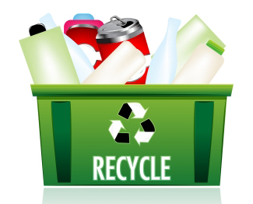
Why have a recycling plan?
To bring the community together in a common vision of public health and environment
To involve the community in setting major program goals
To define roles and responsibilities for recycling operations

Slide 4
Goals of the Plan
Bring the Tribe’s recycling operations to the highest possible level of efficiency
Provide comprehensive service at appropriate levels of cost to the department and its customers
Bring community members together to discover how directly recycling impacts the quality of life
To ask individuals to contribute ideas and help bring about positive change

Slide 5



Reduction
Taking steps to generate less waste, such as:
  Using washable sport bottles and coffee mugs instead of disposable cups
  Copying on both sides when possible
  Repairing instead of replacing
  Buying refillable ink pens

Slide 6



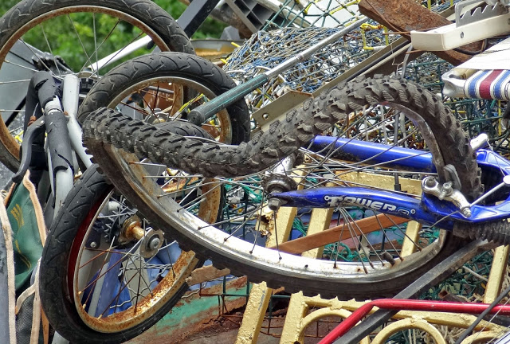
Reuse
Repairing something to extend its use.
Reusing an item for a different purpose.
Used water/soda bottles
Old folders and binders
Paper that had only one side written on it can be reused
Share used books with friends
Purchase and use supplies from recycled products

Slide 7

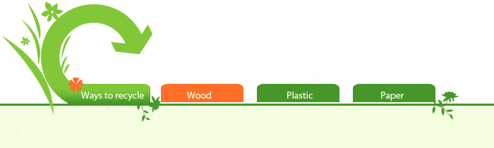
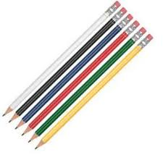
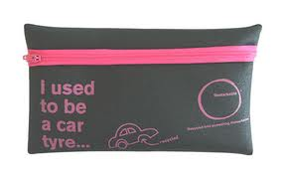
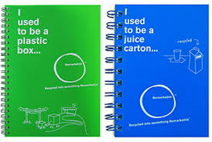
Recycling (collection)
Shredded paper
Ground tires into asphalt
Turning aluminum cans into patio furniture or new cans
Milk jugs into plastic lumber furniture
Soda bottles into filler or poly-cotton t-shirts

Slide 8


Composting
Using nature’s process to turn organics like food waste, yard waste and manure into soil improvement.
Final Product
High nitrogen (‘greens’): non-meat food scraps, grass clippings
High carbon (‘browns’: fallen leaves, tree trunks and branches, scrap wood, low-value paper
Adds organic material as well as chemical nutrients for soil
Improves water retention of soil (holds 150% of own weight in water)
Improves disease and pest resistance of plants

Slide 9
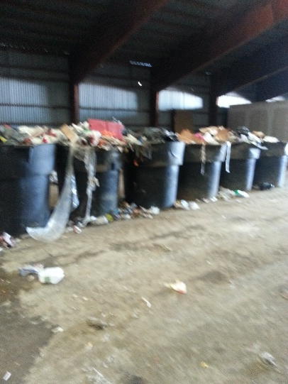
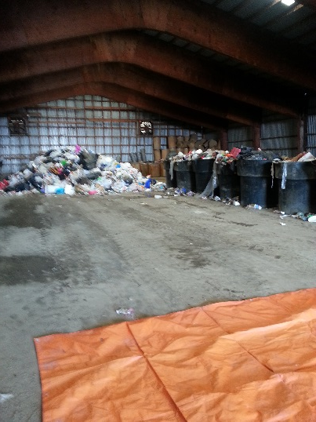
Final Disposal (landfilling)
Allows no way to recover incurred costs of collection and transport
Offers no way to obtain revenue
Wastes potential raw materials
Landfill is a constantly diminishing commodity
Should be method of last resort

Slide 10


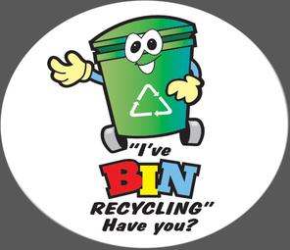
FYI
Everybody creates waste and they can control how much they create
Disposing waste in a landfill costs – regardless of who or where it’s collected from
There is no method of waste disposal that’s free…you either pay money to do it right or you pay later with health impacts and/or high disease rates
It costs staff time to move it aside and sort through it
It delays or prevents performance of scheduled daily tasks

Slide 11
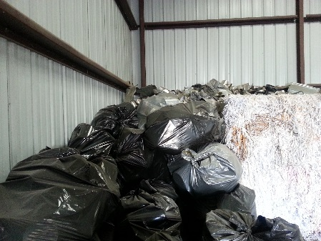
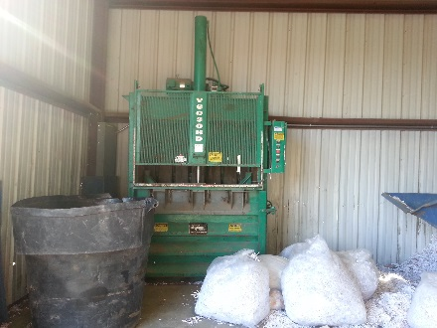
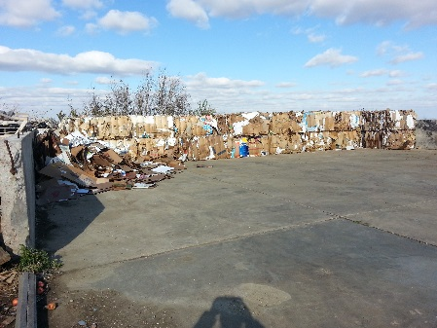
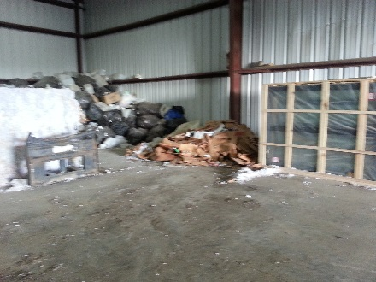
Yankton Sioux Tribe Recycling Center
Paper
Cardboard
Newspaper
Plastic Bottles
Metal Cans
Aluminum Cans

Slide 12



Yankton Sioux Tribe Utilities Staff
YST - Utilities Manager
  Mr. Bryan Heth
  Sheldon Powers
  Ronald Knudsen

